Slide 1
CORRELATING AND EXTRAPOLATING AIR-PURIFYING RESPIRATOR CARTRIDGE BREAKTHROUGH TIMES –A CRITICAL REVIEW
Gerry O. Wood, PhD
Gerry Odell Consulting
Los Alamos, New Mexico, USA
Anjali Lamba, MPH, CIH
U.S. Environmental Protection Agency

Slide 2
EPA Need for Guidance
Toxic Substances Control Act (TSCA) of 1976
New Chemicals – Pre-Manufacture Notice
Testing of Cartridges Required
  Use of APRs with Cartridges
  Change-Out Schedule Requirement
Specific submitter case - identified need for updated recommendations for testing and data analysis.

Slide 3
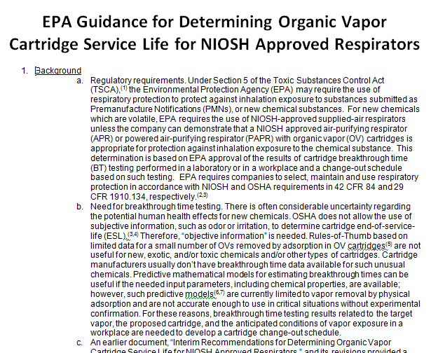
New EPA Guidance Document

Slide 4
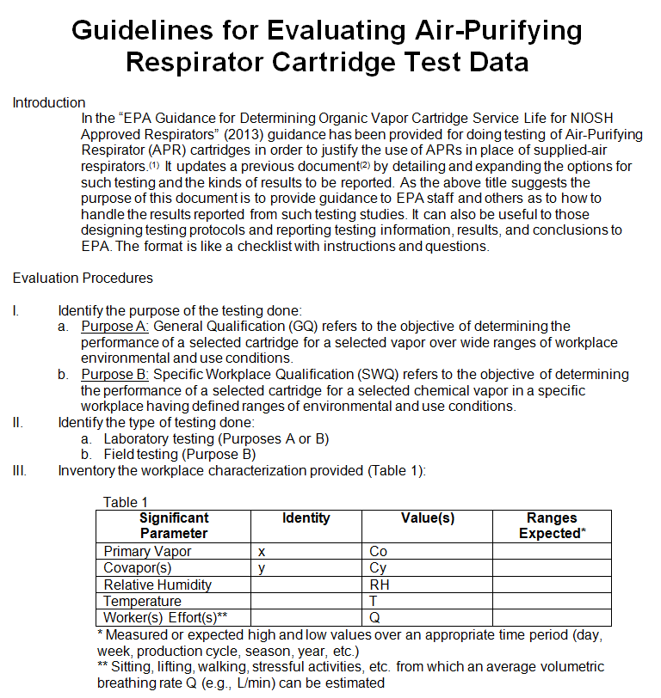
Companion Document

Slide 5
Background
Air-Purifying Respirator Cartridges for Gas/Vapor Removal
  Tested for > 100 years
  Data modeled for > 50 years
Cannot test for all possible use conditions
Helpful to be able to extrapolated/interpolate to untested conditions
Most significant use conditions include
  Concentration
  Air flow (breathing) rate
  Humidity
  Temperature
  Interfering covapors or gases

Slide 6
Objective
Models can be used to interpolate or extrapolate measured breakthrough times for untested conditions.
  Graphs
  Equations
  Rules of Thumb
  Computer programs of complex models
Objective: A critical review of models in the literature.
  New data has been developed over decades
  New understanding of adsorption and chemical removal by impregnants and adsorbed water

Slide 7
Appendices Outline
Correlations of Breakthrough Times by Empirical Relationships
  Breakthrough curve analysis
  Breakthrough time analysis
  Varying concentration data analysis
  Relative humidity effects analysis
  Temperature effects analysis
  Multiple vapor effects analysis
Extrapolation and Interpolation Using Complex Models and their Derived Computer Programs
  Manufacturers’ programs
  OSHA Advisor Genius
  MultiVapor on NIOSH website
  GasRemove
Evaluations of Rules of Thumb
  Examples from the OSHA website

Slide 8
Fundamental Breakthrough Time Equation
(
)
(
)
(
)
W_{e} W W_{e} ρ_{B} C_{o} – C_{b}
t_{b} = ------- -- ------- ln ---------- (1)
C_{o} Q k_{v} C_{o} C_{b}
where W_{e} = adsorption capacity (g vapor/ g sorbent)
k_{v} = adsorption rate coefficient (min⁻¹)
W = weight of sorbent (g)
Q = air flow rate (L/min)
ρ_{B} = packed bed density (g/cm³)
C_{o} = vapor challenge concentration (g/L)
C_{b} = breakthrough concentration (g/L)

Slide 9
Correlations of Breakthrough Times for Extrapolations
Analysis | Equations
Breakthrough curve | Curve fitting of C_{b} or (C_{b}/C_{o})vs. t S-shaped curve to Eq. (1) to extract k_{v} and W_{e} . Linear plots, ln [C_{b} / (C_{o} – C_{b})] vs. t_{b} is often linear with k_{v} = -Intercept * ρ_{B} Q / W and W_{e} = -(Intercept/Slope) * C_{o} Q / W . Need > 3 data to confirm linearity.
Breakthrough time | Varying sorbent weight or volume for fixed C_{o} and C_{b} then t_{b} vs. W is often linear with k_{v} = -(Slope/Intercept) * ρ_{B} Q ln[(C_{o} – C_{b})/C_{b}] and W_{e} = Slope * C_{o} Q. Varying air flow rate Q then t_{b} vs. 1/Q is often linear with k_{v} = -(Slope/Intercept) * (ρ_{B} / W) ln[(C_{o} – C_{b})/C_{b}] and W_{e} = Slope * C_{o} / W. Varying bed residence time t_{R} = (V_{B} / Q) (60 sec/min) (1 L / 1000 cm³) by varying bed volume V_{B} and/or Q then t_{b} vs. t_{R} is often linear with k_{v} = -(Slope/Intercept) * ln[(C_{o} – C_{b})/C_{b}] and W_{e} = Slope * C_{o} / ρ_{B}
Varying concentration | Linear plots of log t_{b} vs. log C_{o} for physically adsorbed vapors have been reported, so t_{b} = 10^{Intercept} * C_{o}^{Slope} and W_{e} = W_{e1} * C_{o}^{Slope+1}.
Relative humidity effects | Linear functions of RH to a power have been observed: t_{b}(dry) / t_{b}(wet) = 1 + Slope * (RH)^{n}
Temperature effects | Linear plots of t_{b} vs. temperature T (ºC) have been reported: t_{b} = t_{b}(reference T) + Slope * T
Multiple vapor effects | Molar additivity method: For an adsorbed vapor x with measured or estimated single vapor breakthrough time t_{bx}, replace C_{o} with C_{o} = C_{x} + Σ (C_{y­}) where C_{x} is the molar (ppm) concentration of the vapor with the shortest breakthrough time and Σ C_{y} is the sum of the molar concentrations of the covapors. Mole fraction method: For an adsorbed vapor x with single vapor capacity W_{e}º and single vapor breakthrough time t_{b}º, use W_{e} = [C_{x} / (C_{x} + Σ C_{y})] W_{e}º and t_{b} = [C_{x} / (C_{x} + Σ C_{y})] t_{b}º
Complex models and computer programs | Breakthrough time estimation model (Wood, 1994). MultiVapor (NIOSH website) GasRemove (GerryOWood.com)

Slide 10
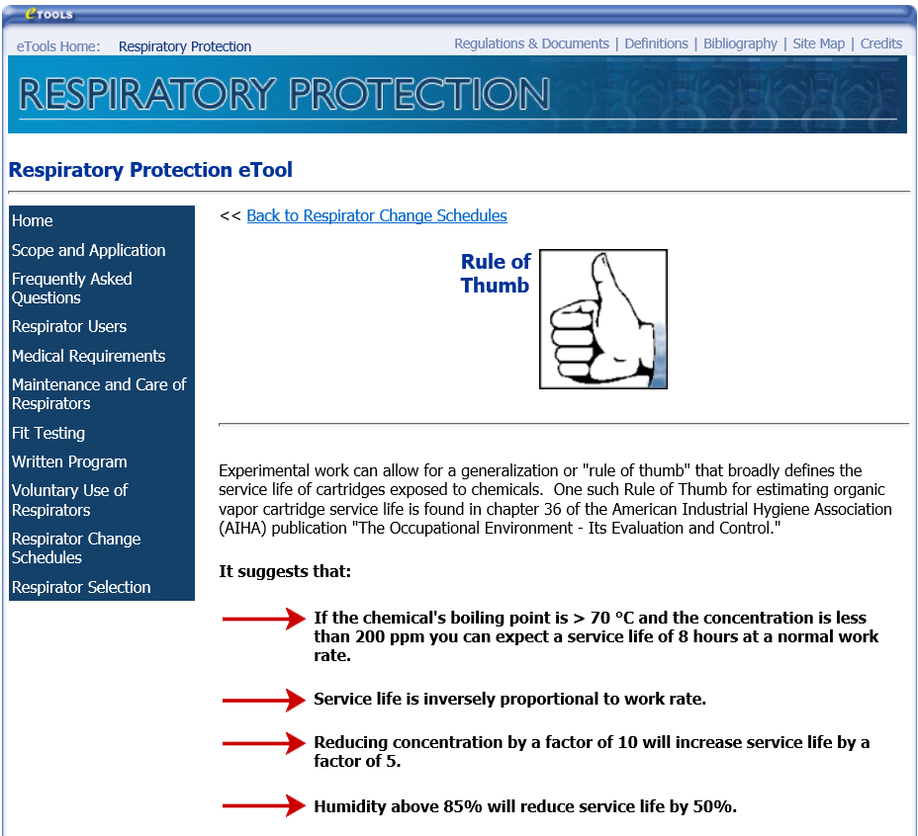

Slide 11
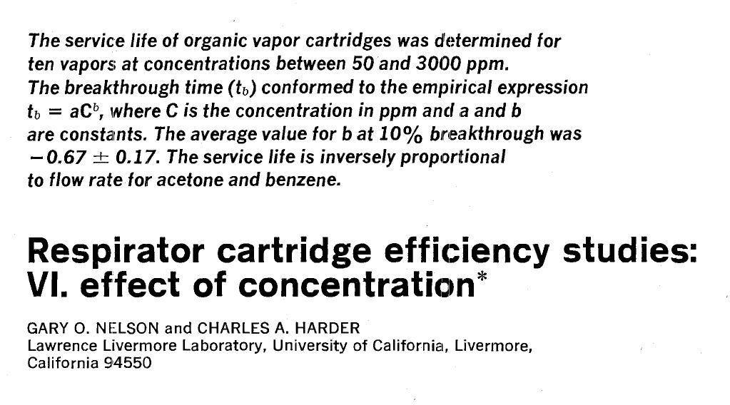
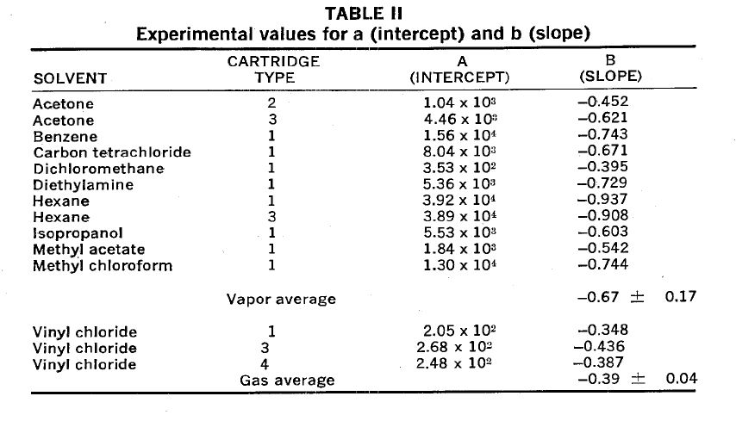
Nelson, G.O. and C.A. Harder: “Respirator Cartridge Efficiency Studies VI. Effect of Concentration,” Am. Ind. Hyg. Assoc. J. 37:205-216 (1976).
OSHA Rule of Thumb:
“Reducing concentration by a factor of 10 will increase service life by a factor of 5.”
10^{0.67} = 4.7
Reality: Range: 10^{0.395} = 2.5 to 10^{0.937} = 8.6

Slide 12
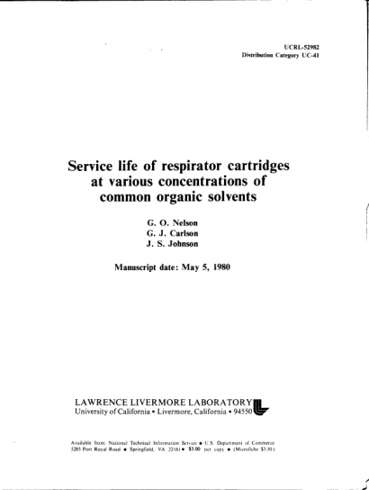
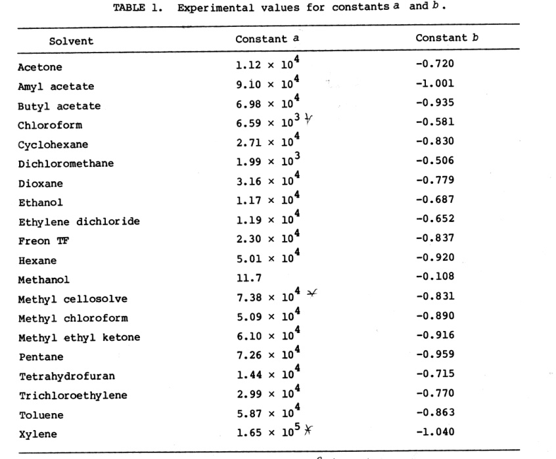
Nelson, G.O., G.J. Carlson, and J.S. Johnson: “Service Life of Respirator Cartridges at Various Concentrations of Common Organic Solvents,” Report UCRL-52982, Lawrence Livermore Laboratory, Livermore, CA (1980).
OSHA Rule of Thumb:
“Reducing concentration by a factor of 10 will increase service life by a factor of 5.”
Reality: Range: 10^{0.108} = 1.3
to 10^{1.040} = 11.0

Slide 13
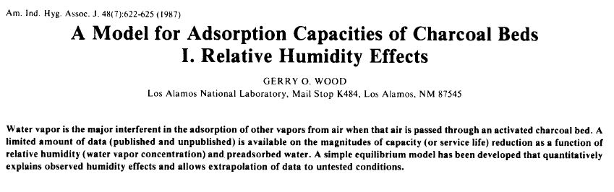
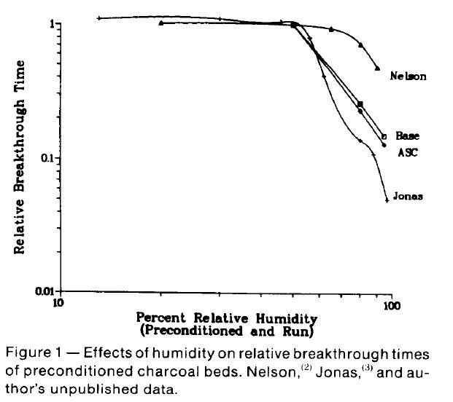
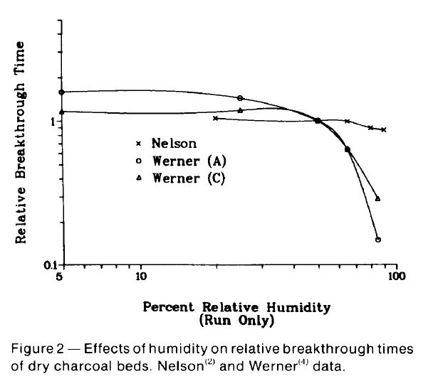
OSHA Rule of Thumb:
“Humidity above 85% will reduce service life by 50%.”
Reality:
RH effect begins below 85% RH.
Reduction can be much more than 50% and it varies with chemical and carbon.

Slide 14
OSHA Rule of Thumb:
“If the chemical’s boiling point is > 70 ºC and the concentration is less than 200 ppm you can expect a service life of 8 hours at a normal work load.”
Chemical | Boiling Point (ºC) | Flow (breathing) Rate (L/min) | Concentration (ppm) | Breakthrough Time (hours)
Benzene | 80.1 | 53.3 | 125 | 5.9
Nelson, G.O. and A.N. Correia: “Respirator Cartridge Efficiency Studies: VIII. Summary and Conclusions,” Amer. Ind. Hyg. Assoc. J. 37, 514-525 (1976).

Slide 15
X
X
X

Slide 16
Career publications and documents available at:
GerryOWood.com

